Slide 1
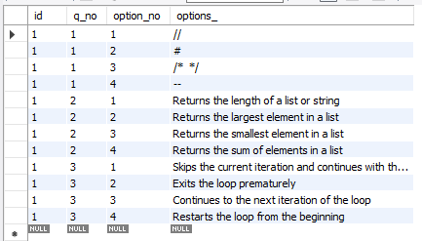



3
Table name:
quiz_options
1
Table name :
quiz_names
2
Table name:
quiz_questions
4
Table name:
quiz_answers

